Slide 1
OOP Principles
Prepared by: Jordan R. Kharkrang

Slide 2
OOP Principles
Encapsulation
Abstraction
Polymorphism
Inheritance

Slide 3

OOP Principles
Encapsulation:
Hides the internal state of one object from another.
It conceals the data.
Example:
Accelerate
Brake
Steer
Burns the fuel
Rotates the tires

Slide 4

OOP Principles
Abstraction:
Presents only the necessary amount of information to the user.
Manage complexity.
Developers uses it to decompose complex systems into smaller components.
Example:

Slide 5
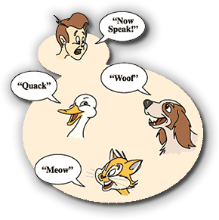
OOP Principles
Polymorphism:
It means Taking many different forms.
It is the ability of one object to be treated and used like another object.
Example:

Slide 6

OOP Principles
Inheritance:
It is a relation.
Inherits attribute and behaviour from Parent class.
Example:

Slide 7
Research Area:
Network Security:

Slide 8
THANK YOU

